Slide 1

Unit 10
JDBC:
Overview of JDBC API: Overview of JDBC API, Types of driver JDBC interface and classes for connecting and retrieving data JDBC interface and classes for connecting and retrieving data, Implement JDBC Type of Statement: Type of Statement, Creating and closing a PreparedStatement, Creating and closing a CallableStatement, Commonly used Methods of ResultSet: Batch Processing: What is Batch Processing, Transaction
Management, Transaction Rollback RowSet and RowSet Types :RowSet and RowSet, Implement CallableStatement
Notes:
1

Slide 2
What is Database?
Database is a collection of information ordered in such a way that computer program can quickly select desired pieces of data.
In other word, Electronic filing system
Conventional databases are organized by fields, records and files.

Slide 3

Databases
DATABASE Name: Details (Collection of tables)
TABLE Name: Person
Query to create DATABASE:
create database Details;
RollNo | Name | Age
1 | Ojaswitaa | 11
2 | Shaanvi | 4
3 | Saanchi | 2
Row (Tuple)
Query to create TABLE:
create table Person(RollNo int,
Name varchar(20),
Age int);
COLUMN (FIELDS)
Query to Fetch/Get Data from TABLE:
SELECT * from Person; //all columns data
select Name, Age from Person where RollNo=2;
Query to insert data into TABLE:
INSERT INTO Person (RollNo, Name, Age) VALUES(4,“Norah”,3);
INSERT INTO Person VALUES (4,“Norah”,3);

Slide 4
Creating databases and tables
CREATING DATABASE AND TABLES USING PHP AND MYSQL
Database Tables
A database can contain one or more tables
Each table has unique name
Tables consists of rows and columns. Rows are called as tuples and columns are called as fields
Queries
A query is used to extract data from the database in a readable format according to the user’s request.
A query is an inquiry into database using the SELECT statement.

Slide 5
Creating databases and tables
Creating The MySQL Database
Since all tables are stored in a database, so first we have to create a database before creating tables.
The CREATE DATABASE statement is used to create a database in MySQL.
Syntax: CREATE DATABASE database_name
Adding Tables To mysql Database / Creating Tables
Since our database is created now it’s time to add some tables to it. The CREATE TABLE statement is used to create a table in MySQL database.
Syntax:
CREATE TABLE table_name
{
column_name1 data_type,
column_name2 data_type,
column_name3 data_type,
…
}

Slide 6
MySQL Data Types
MySQL supports a number of different data types, the most important ones are summarized below.
Field Type | Description
INT | A numeric type that can accept values in the range of 2147483648 to 2147483647
DECIMAL | A numeric type with support for floating-point or decimal numbers
CHAR | A string type with maximum size of 255 characters and a variable length
VARCHAR | A string type with maximum size of 255 characters and a variable length
TEXT | A string type with a maximum size of 65535 character
DATE | A date field in the YYYY-MM-DD format
TIME | A time field in the HH:MM:SS format
DATETIME | A combined date/time type in the YYYY-MM-DD HH:MM:SS

Slide 7
Why use Database?
Retrieving Information: Allows us to regain information more proficiently, more flexibly and more artistically.
Storing Information: Enables us to store larger amount of information than a normal file.
Manipulating Information: A database can control the information it contains.
Printing Information: Enables us to print our information on labels, fax cover sheet, reports and letters.

Slide 8

What is JDBC?
Java Database Connectivity is a Java API for executing SQL statements and supports basic SQL functionality.
JDBC is API that defines interface and classes for writing database applications in java by making database connections.
It is a program designed to access many popular DB products on a number of OS platforms.
We can send SQL,PL/SQL statements to almost any relational DB.

Slide 9
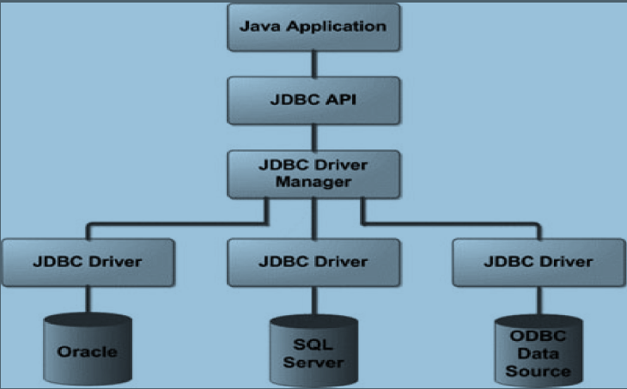
JDBC Architecture

Slide 10
JDBC
JDBC API
  Provide facility for accessing the relational database from Java programming language.
  JDBC API consist of two packages
    java.sql
    javax.sql(Java Enterprise Edition: client-side and server-side)
JDBC DriverManager
  Manages a list of database drivers
  Matches connection from java application with the proper database driver using communicating sub protocol.

Slide 11
JDBC
  The main responsibility for JDBC driver manager is to load all the drivers found in the system property
JDBC Driver
  Is an interpreter that translates JDBC method calls to vendor-specific database commands
Database commands
JDBC calls
Driver
Database
Notes:
11
About JDBC Drivers
A JDBC driver implements the interfaces in the java.sql package, providing the code to connect to and query a specific database. A JDBC driver can also provide a vendor’s own extensions to the standard; Oracle drivers provide extensions to support special Oracle data types.
Oracle provides three drivers:
Thin client driver
OCI-based driver
Server-based driver
These are described on the following pages.

Slide 12
Overview of Querying a Database With JDBC
Connect
Query
Process
results
Close

Slide 13
Stage 1: Connect
Connect
Register the driver
Query
Connect to the database
Process
results
Close
Notes:
13

Slide 14
Stage 2: Query
Connect
Query
Create a statement
Process
results
Query the database
Close
Notes:
14

Slide 15
Stage 3: Process the Results
Connect
Query
Step through the results
Process
results
Assign results to Java
variables
Close
Notes:
15

Slide 16
Stage 4: Close
Connect
Query
Close the result set
Process
results
Close the statement
Close
Close the connection
Notes:
16

Slide 17
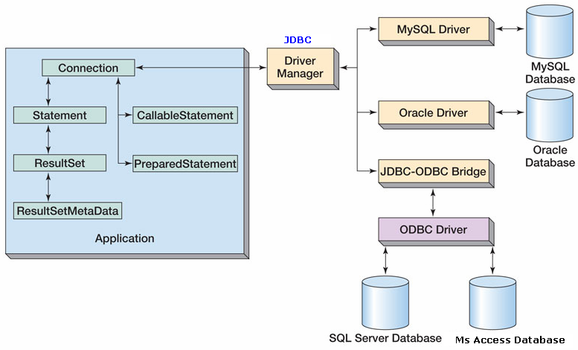
JDBC Components

Slide 18
Java DB Connectivity Steps
Step 1:
  To start with java JDBC connection to the database, we must first import java.sql package.
Step 2:
  Loading a database driver:
    The driver class is loaded by calling Class.forName() with the driver name as an argument.
    The return type of the Class.forName(String classname) method is “Class” & it is present in java.lang package.
    For ex.
      Class.forName(“com.mysql.jdbc.Driver”);
      Class.forName("sun.jdbc.odbc.JdbcOdbcDriver");
      Class.forName("oracle.jdbc.driver.OracleDriver“);

Slide 19
Java DB Connectivity Steps(Contd.)
Step 3:
  Creating Jdbc Connection
    The JDBC DriverManager class defines objects which can connect Java application to a JDBC driver. It manages the JDBC drivers that are installed on the system.
    It uses getConnection() method to establish a connection to a database and it returns connection object.
    An application can have one or more connections with a single database or it can have many connections with different database.
  Jdbc URL
    JDBC uses a URL to identify the database connection.
    Each driver has its own sub protocol
    each sub protocol has its own syntax for the source

Slide 20
JDBC URLs
  For example.
    For MS Access/SQL server Connection
  Connection con = DriverManager.getConnection("jdbc:odbc:dsn_name");
jdbc:<subprotocol>:<subname>
Database
identifier
Protocol
Sub protocol
jdbc: odbc: < Data source name >
Notes:
20
JDBC URLs
JDBC uses a URL to identify the database connection. A JDBC URL looks different from an HTTP or FTP URL; but like any URL, it is a locator for a particular resource, in this case a database. The structure of a JDBC URL is flexible, allowing the driver writer to specify what to include in the URL. End users need to learn what structure their vendor uses.
The slide shows the general syntax for a JDBC URL, and the syntax that Oracle uses for connecting with an Oracle driver. The general syntax of a JDBC URL is as follows:
jdbc:<subprotocol>:<subname>
jdbc is the protocol. All URLs start with their protocol.
<subprotocol> is the name of a driver or database connectivity mechanism. Driver developers register their subprotocols with JavaSoft to make sure that no one else uses the same subprotocol name. For all Oracle JDBC drivers, the subprotocol is oracle.
<subname> identifies the database. The structure and contents of this string are determined by the driver developer. For Oracle JDBC drivers, the subname is:
<driver>:@<database>
<driver> is the driver
<database> provides database connectivity information
The following slides describe the syntax of an Oracle JDBC URL in more detail, and explain how to use a JDBC URL to connect to a database.

Slide 21
JDBC URLs
  For MySQL Connection
  Connection con= DriverManager.getConnection(“URL of DB”,”loginname”,”passwrd”);
jdbc:<subprotocol>:<subname>
Database
identifier
Protocol
Sub protocol
jdbc:mysql://host[:port]/database

Slide 22
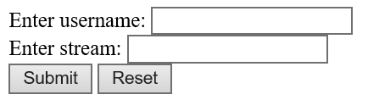
DatabaseHandling .java
import java.util.*;
import java.sql.*;
public class DatabaseHandling
{ public static void main(String args[])
{
Scanner sc = new Scanner(System.in);
System.out.println("Enter student name : ");
String name=sc.next();
System.out.println("Enter stream: ");
String stream=sc.next();
try
{
Class.forName("com.mysql.jdbc.Driver");
Connection con = DriverManager.getConnection("jdbc:mysql://localhost:3306/student", "root", “ganpat");

Slide 23
Java DB Connectivity Steps(Contd.)
Step 4:
  Creating JDBC Statement Object:
    Once connection is obtained we can interact with the database. Connection interface defines methods for interacting with the database through the established connection.
    To execute SQL statements, we have 3 kinds of statements:
    Standard Statement:
      It executes simple SQL queries without parameters. This statements creates an SQL Statement object.
Syntax: Statement stmt=con.createStatement();

Slide 24
Java DB Connectivity Steps(Contd.)
b) Prepared Statement:
    It executes a precomplied SQL queries with or without parameters. It returns PreparedStatement object.
    Syntax:
    PreparedStatement pstmt= con.prepareStatement(“insert into detail values(?,?,?)”);
pstmt.setInt(1, x);
pstmt.setString(2, y);
pstmt.setInt(3, x);
c) Callable Statement:
    It executes a call to a database stored procedure. It returns new CallableStatement object.
Syntax:
CallableStatement cstmt= con.prepareCall(“{call getEmployee(?,?)}”);

Slide 25
DatabaseHandling.java
Scanner sc = new Scanner(System.in);
System.out.println("Enter student name : ");
String name=sc.next();
System.out.println("Enter stream: ");
String stream=sc.next();
try
{
Class.forName("com.mysql.jdbc.Driver");
Connection con=DriverManager.getConnection("jdbc:mysql://localhost:3306/student","root",“ganpat");
PreparedStatement pstmt= con.prepareStatement(“insert into sdetail values(?, ?)”);
pstmt.setString(1, name);
pstmt.setString(2, stream);
OR
PreparedStatement pst = con.prepareStatement(“select * from sdetail where name=?”);
pst.setString(1,name);

Slide 26
Java DB Connectivity Steps(Contd.)
Step 5:
  Executing SQL Statement:
The Statement class has three methods for executing statements
a) executeQuery()- for select statement.
b) executeUpdate()- for creating or modifying tables.
c) execute()- executes SQL statement that is written as String object.
Step 6:
- Take data
  executeUpdate() always return integer value indicating how many row affected.
  executeQuery()- always returns ResultSet object which hold table data.
  execute()- always return Boolean value .

Slide 27
Java DB Connectivity Steps(Contd.)
  ResultSet provides access to a table of data generated by executing a Statement. The table rows are retrieved in sequence. The next() method is used to successively step through the rows of the tabular results.
  For ex.
  ResultSet rs= stmt.executeQuery(“select * from tablename”);
  while(rs.next()) { }
Step 7: Close The Connection:
    Database is valuable resource and also consumes lot of memory for creation and execution, therefore it is necessary to close the connection.
Syntax: rs.close();
stmt.close();
con.close();

Slide 28
DatabaseHandling.java
String name=sc.next();
String stream=sc.next();
try
{
Class.forName("com.mysql.jdbc.Driver");
Connection con=DriverManager.getConnection("jdbc:mysql://localhost:3306/student","root",“pat");
PreparedStatement pstmt= con.prepareStatement(“insert into sdetail values(?, ?)”);
pstmt.setString(1, name);
pstmt.setString(2, stream);
int row=pstmt.executeUpdate();
OR
PreparedStatement pst = con.prepareStatement(“select * from sdetail where name=?”);
pst.setString(1, name);
ResultSet rs=pst.executeQuery();
while(rs.next()) { out.println(“Hi “+rs.getString(1)); }

Slide 29
Example:
Table Name: sdetail
name | stream
SHAANVI | Arts
SAANCHI | IT
OJASWITAA | CS
PreparedStatement pst = con.prepareStatement(“select * from sdetail”);
ResultSet rs=pst.executeQuery();
while(rs.next())
{
out.println(“Hi ”+rs.getString(1)+“<br>”);
}
OUTPUT:
Hi SHAANVI
Hi SAANCHI
Hi OJASWITAA
Explanation: getString(1) -> name;
getString(2) -> stream

Slide 30
EID | ENAME | ESALARY | EAGE
1 | SAANCHI | 100000 | 12
2 | OJASWITAA | 5000 | 12
PreparedStatement pst = con.prepareStatement(“select * from sdetail where name=?”);
ResultSet rs=pst.executeQuery();
OR
int row=pst.executeUpdate();
OR
Boolean ans=pst.execute();

Slide 31
DatabaseHandling.java
String name=sc.next();
String stream=sc.next();
try
{
Class.forName("com.mysql.jdbc.Driver");
Connection con=DriverManager.getConnection("jdbc:mysql://localhost:3306/student","root",“pat");
PreparedStatement pstmt= con.prepareStatement(“insert into sdetail values(?, ?)”);
pstmt.setString(1, name);
pstmt.setString(2, stream);
int row=pstmt.executeUpdate();
if(row==1)
{
out.println(“Data updated Successfully”);
}
}
catch(Exception e)
{
System.out.println(e);
}

Slide 32
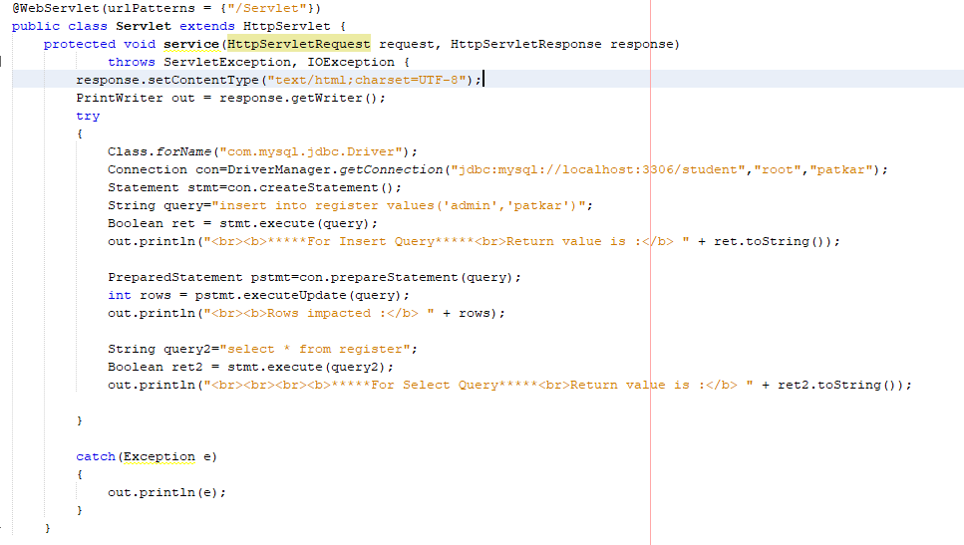

Slide 33
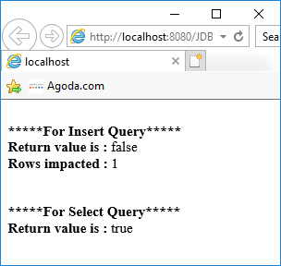

Slide 34
